Slide 1

MIS 665 – Final Project
Author: Ashton Vega

Slide 2
Key Findings - Regression
Linear Regression – 32% accurate
Random Forest – 90% accurate (89% once remove highest importance feature)
Lasso – 32% accurate
Ridge – 32% accurate
Feature Selection – 31.6% accurate
Random Forest Feature Selection – 90.7% accurate (86% once remove 3 highest importance features)

Slide 3
Key Findings - Classification
Decision Tree – 67.5% accuracy
Knn 61.47% accurate
Logistic Regression – 63.3% accurate
Random Forest – 74% accurate
10-Fold cross validation results..
DT – 64.4%
Knn – 48%
LR – 63.3%
RF – 73.5%

Slide 4
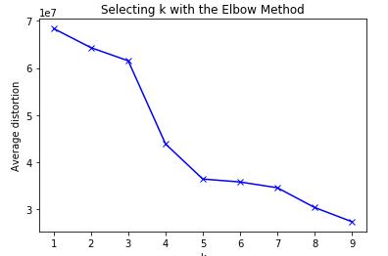
Key Findings - Clustering
Ideal K value is 3
3 significantly different clusters
Cluster 0
High Echelon Movies
Cluster 1
Low Echelon Movies
Cluster 2
Middle Echelon Movies

Slide 5
Story Telling
The variables that are considered important to predict IMDB score and movie success?
Movie duration
Popularity
Budget
Duration

Slide 6
Story Telling – Recommendations
Producers
Focus on good actors and a quality director.
Lengthy movie is better than shorter
Generate some buzz!
Investors
Just because a movie doesn’t fit a specific set of categories, does not mean it is not a good movie
Viewers
Judge movies based on the content, not because it “meets” or “doesn’t meet” certain standards

Slide 7
Story Telling – Additional Variables
Time of release
Other films released at the same time
Economic environment

Slide 8
Other Suggestions
Movie success is extremely hard to predict and, on average, most models only provide 32% accuracy.
These models can be used to help predict success, not guarantee it

